Slide 1

Dynamic Emotion Recognition Using Hybrid Deep Learning Models
Project Associates | Project Guide
20P31A1258 Tata P N V S Satyanarayana Murthy | N. Surya Kala M.Tech., Asst. Prof
20P31A1239 Nekkanti Sai Chaitanya
20P31A1221 Karri Mousami Reddy
20P31A1208 Biradha Dileep Krishna Kumar
Department of Information Technology
Aditya College of Engineering & Technology (A)

Slide 2
Abstract
Emotion recognition is an advanced technology used to interpret and classify human emotions based on facial expressions and non-verbal cues.
According to the history involved, spoken communication reflects 7% of the message in personal communication. Voice gives 38% and facial expression produces 55% of the message. As per research, the prominent descriptors of feelings of humans are “Emotions’’.
It is essential for simple and straightforward recognition of human psychology at particular instant without really asking them.
Users need human-like interactions to better communicate with computers i.e., Human Computer Interaction (HCI) which is essential for the humanization of AI.
This model can be used in various real time applications such as human computer interactions i.e., for virtual assistants, For personalised learning, to improve customer service, healthcare monitoring, security and surveillance etc.,
Dynamic Emotion Recognition Using Hybrid Deep Learning Models

Slide 3
Literature Survey
An Efficient Approach to Face Emotion Recognition with Convolutional Neural Networks:
This research focuses on devising a streamlined and effective method for detecting and recognizing emotions from facial expressions using Convolutional Neural Networks (CNNs).
https://www.mdpi.com/2079-9292/12/12/2707
Advancing Facial Expression Recognition in Online Learning Education Using a Homogeneous Ensemble Convolutional Neural Network Approach:
This paper propose an ensemble learning method called homogeneous deep learning. Homogenous deep learning entails the use of similar kinds of CNNs, for which we chose between six and seven ensembles from DCNN, EfficientNetB2, InceptionRestNetV2, ResNet50, Xception, DenseNet, and VGG16, respectively.
https://www.mdpi.com/2076-3417/14/3/1156
Dynamic Emotion Recognition Using Hybrid Deep Learning Models

Slide 4
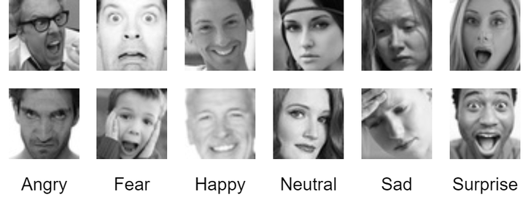
Dataset
Custom Dataset:
The dataset contains grayscale images of faces displaying various facial expressions, such as happy, sad, angry, neutral, surprise and fear.
Each image is labeled with the corresponding emotion. Images are taken form CK+ and FER datasets avaliable in the kaggle repository.
Dynamic Emotion Recognition Using Hybrid Deep Learning Models

Slide 5
Existing System
Convolution neural networks have been employed to analyse facial expressions in the existing systems which are mainly of static based and they only can recognise emotions from static images.
Because of which, it was difficult to predict emotions with higher accuracy on real time video because of the absence of model training on temporal dependencies.
The existing system uses different architectures of Convolutional Neural Network (CNN) for feature extraction and classification.
Feature Extraction: Utilizes convolution and pooling layers for extracting meaningful features from facial images.
Classification: SoftMax layer is employed for classifying facial expressions into different emotion classes.
The system primarily focuses on static images and mentions video data in a limited context. However, real-world scenarios often involve dynamic changes in facial expressions.
Dynamic Emotion Recognition Using Hybrid Deep Learning Models

Slide 6
Accuracy Comparision
Models | Accuracy(%)
5-layerCNN | 67.69
6-layerCNN | 67.63
RESNET50 | 72.72
VGG16 | 70.22
Xception | 65.19
DCNN | 66.75
EfficientNetB2 | 68.09
DenseNet | 69.10
ProposedMethod(CNN-LSTM) | 92.07
Dynamic Emotion Recognition Using Hybrid Deep Learning Models

Slide 7
Proposed System
Feature extraction methods for video based emotion recognition can be roughly divided into two types: Static-based methods and Spatial-temporal methods.
Static-based feature extraction methods mainly inherit those features from static image emotion recognition only whereas spatial-temporal methods aims to model the temporal or motion information in videos. The Convolution Neural Network (CNN) along with Long-Short-Term-Memory (LSTM) was used to get spatial features & temporal features for video based emotion recognition in our model.
CNN excel at spatial feature extraction to learn features from individual frames and LSTM’s excel at temporal memory to capture the dynamic changes in facial expressions overtime.
Our proposal system combines the strengths of both CNN and LSTM.
Dynamic Emotion Recognition Using Hybrid Deep Learning Models

Slide 8
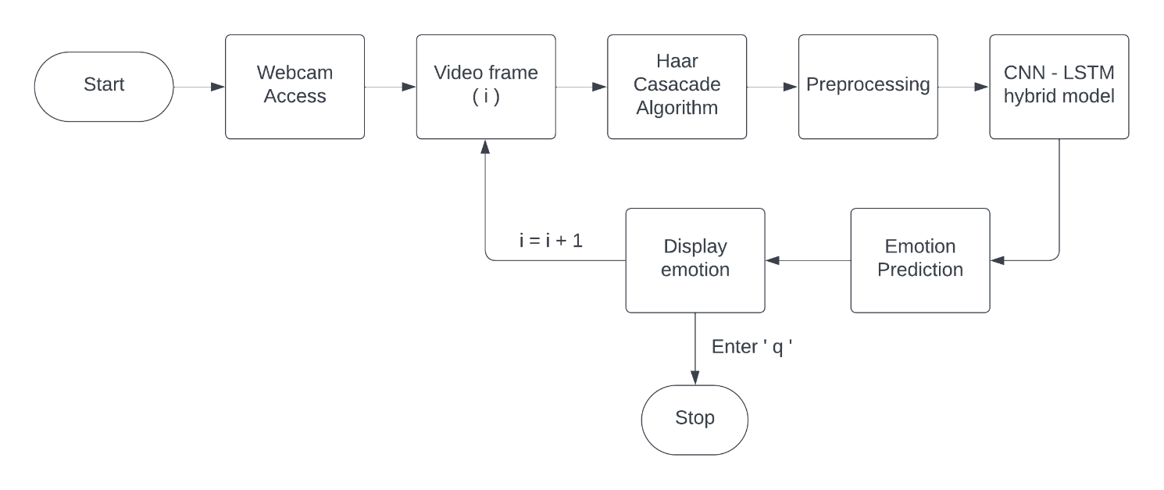
Proposed System
Upon developing out hybrid CNN-LSTM model, we now have to make our model work in dynamic nature.
We have made use of OpenCV library and accessed users webcam feed directly.
Now we will make use of weights of our model saved to make predictions.
HaarCascade object detection algorithm will be applied to each frame and faces are now being identified and made predictions using our model.
Users have the feature of quitting from the webcam by entering ‘q’.
Dynamic Emotion Recognition Using Hybrid Deep Learning Models

Slide 9
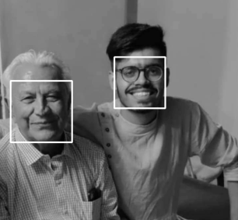
Methodology
OpenCV : A python library of programming functions mainly for real-time computer vision. It contains a main module called a cv2.
Webcam was accessed using the cv2 module of python and frames are accessed continuously.
Haar-Cascade : Haar cascade is an algorithm that can detect objects in images, irrespective of their scale in image. It is computationally less expensive, a fast algorithm, and gives high accuracy.
Faces are detected from frames using an object of ‘haarcascade_frontalface_default.xml’ file of Haar-Cascade classifier and was pre-processed to predict emotions.
Dynamic Emotion Recognition Using Hybrid Deep Learning Models

Slide 10
Methodology
Emotions are predicted using our hybrid CNN-LSTM model on the faces detected.
Taking feed from webcam was stopped when user enters ‘q’.
This model was dynamic and detects emotions of several people in a single frame.
Grayscale images are used for the training of the model because they have only one channel as opposed to three channels which reduces the size of each image and the overall data set leading to faster processing times and lower storage requirements.
Also sometimes colour can be distracting from the underlying shape and texture of facial features which are crucial for emotion recognition, grayscale images eliminates this distraction.
Dynamic Emotion Recognition Using Hybrid Deep Learning Models

Slide 11
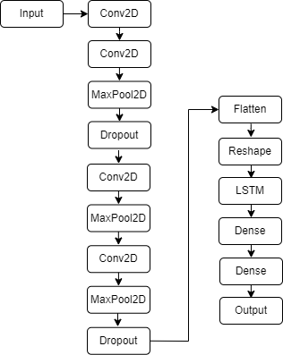
Architecture
Dynamic Emotion Recognition Using Hybrid Deep Learning Models

Slide 12
Functional Requirements:-
Ease of Use:
It can be implemented on any platforms.
It is compatible with any system like a laptop & system.
High Performance:
The system should be capable of processing dynamic video streams in real-time with minimal latency. It should be
able to efficiently analyze facial expressions and emotions using the CNN+LSTM deep learning models within an
acceptable response time, ensuring smooth and uninterrupted user experience.
Dynamic Emotion Recognition Using Hybrid Deep Learning Models

Slide 13
Non-Functional Requirements:-
Software Requirements:
• Operating System: - Windows, Linux, MacOS
• IDE :– Jupyter Notebooks
• Programming Language:- Python
• Libraries/Packages:- Tensorflow, Keras, Opencv, Pandas, Numpy.
Hardware Requirements:
• Processor: - i3 & above
• Ram: - Minimum 4GB & above
• Hard Disk: - 1TB
• System Type: - 64 bit
Usability:
This is used to Detect the emotions in a real time video for increasing the computer-human interaction
Dynamic Emotion Recognition Using Hybrid Deep Learning Models

Slide 14
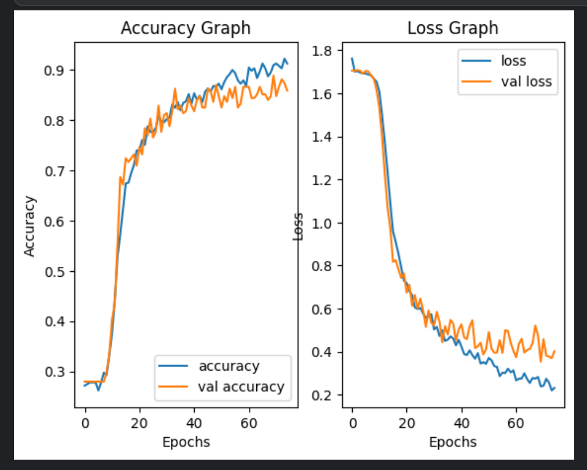
Results
The below graphs shows our models accuracy and loss comparison for training and validation dataset for 75 epochs under our dataset.
We have got around ~92% of training accuracy and ~86% of testing accuracy.
Dynamic Emotion Recognition Using Hybrid Deep Learning Models

Slide 15
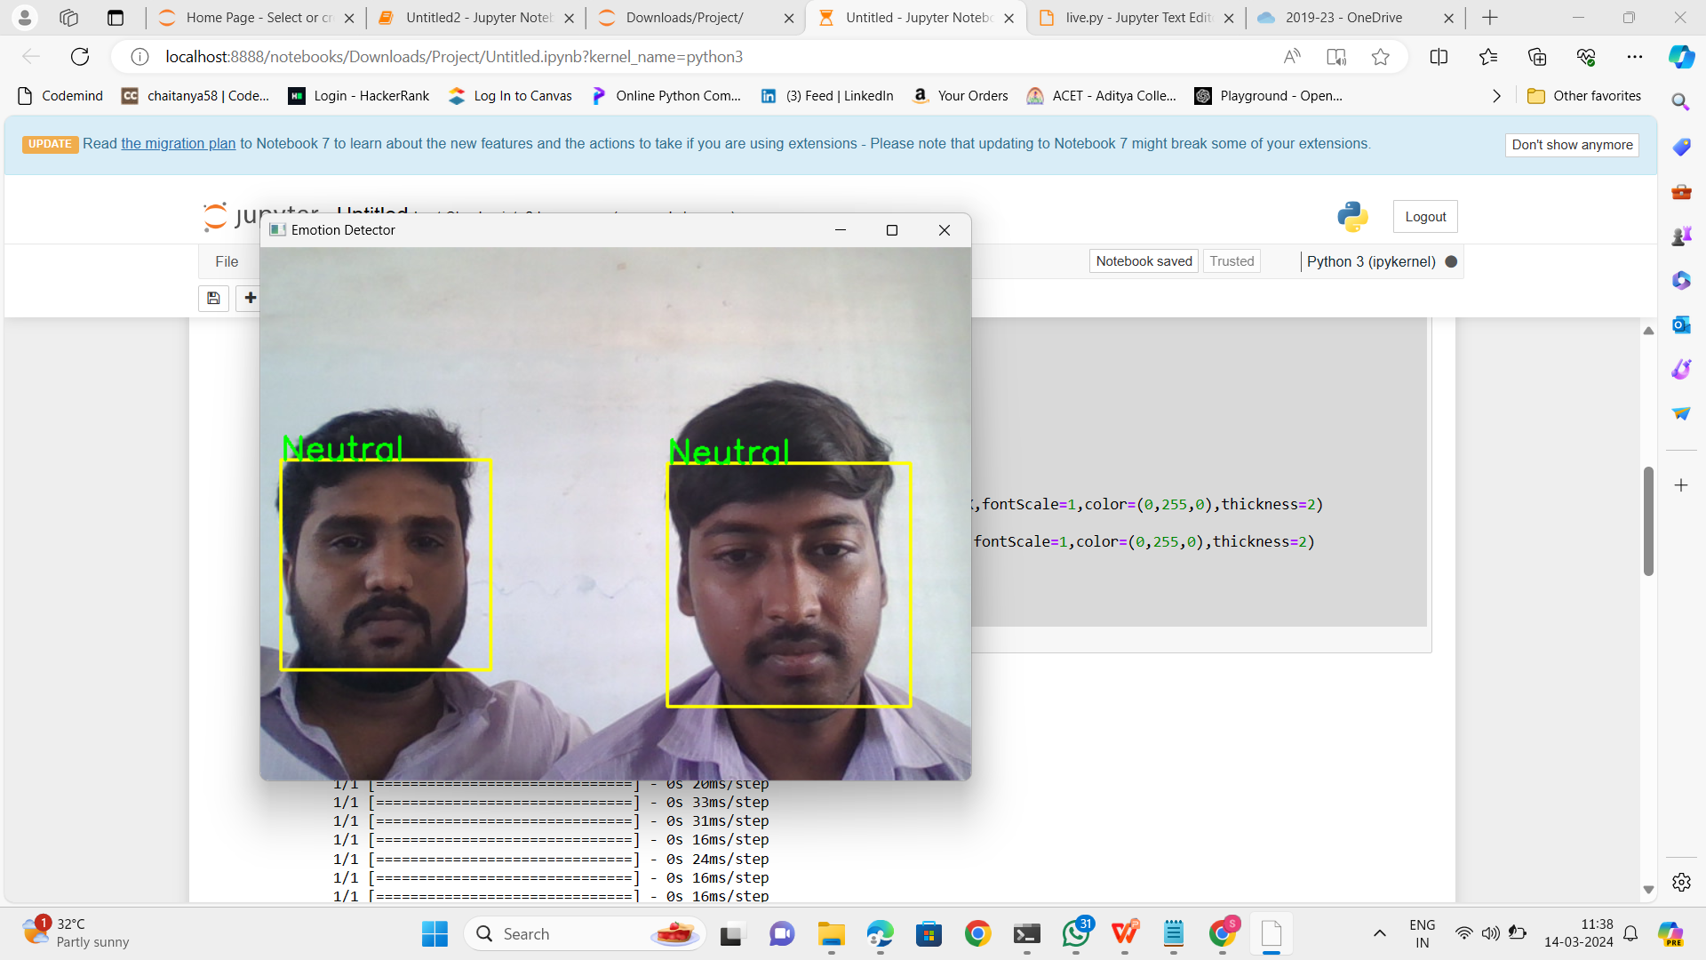

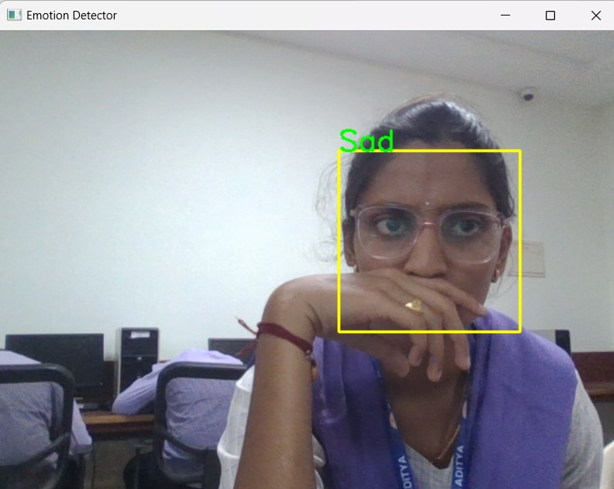
Test Cases
→ Neutral
→ Fear
→ Sad
Dynamic Emotion Recognition Using Hybrid Deep Learning Models

Slide 16
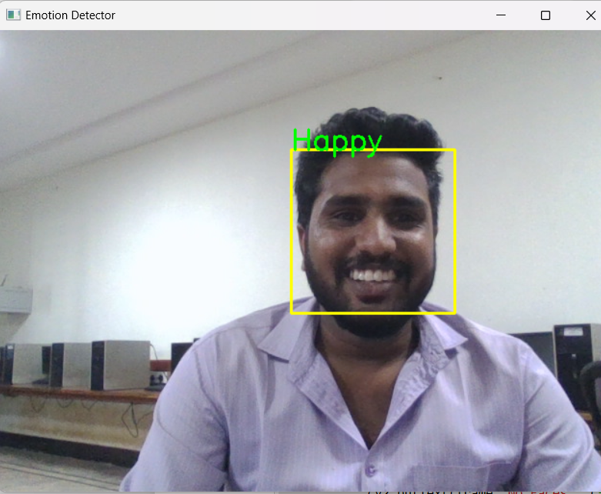
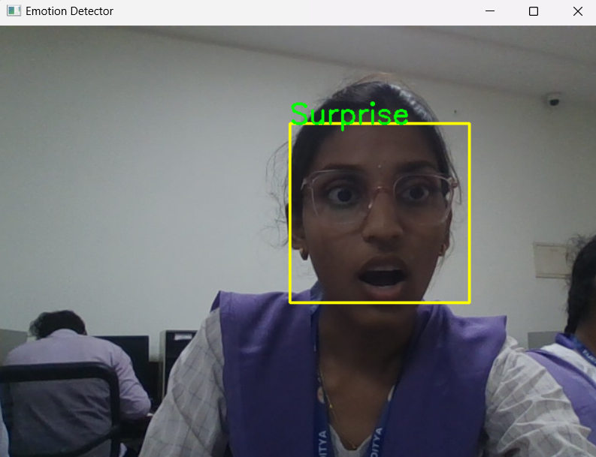
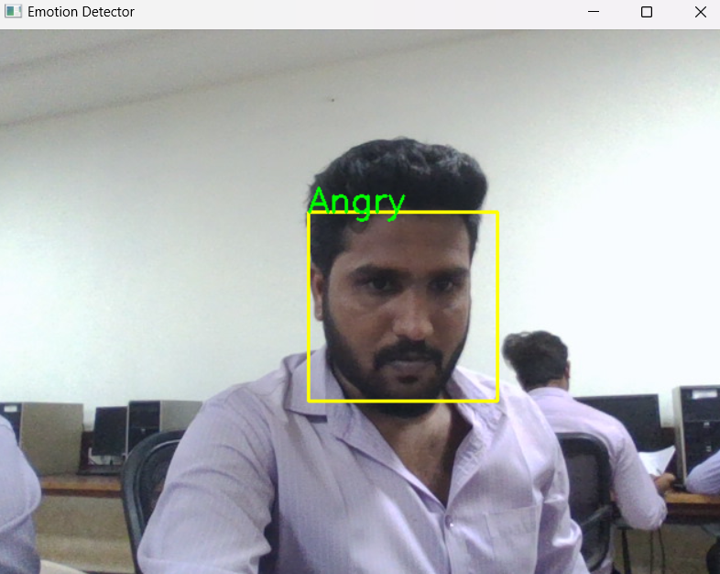
Test Cases
→ Happy
→ Surprise
→ Angry
Dynamic Emotion Recognition Using Hybrid Deep Learning Models

Slide 17
Conclusion
This project explored the development of a hybrid CNN-LSTM model for video-based emotion recognition. We addressed the limitations of CNNs in capturing the temporal dynamics of emotions within video sequences. The proposed model leverages the strengths of both architectures:
• CNNs: Effectively extract informative spatial features (facial landmarks, wrinkles) from each video frame.
• LSTMs: Analyze the sequence of feature vectors, capturing the evolution of expressions over time.
This combined approach leads to a more comprehensive understanding of the emotional content in videos. Our findings demonstrate that the hybrid CNN-LSTM model achieves significantly higher accuracy in recognizing emotions compared to using CNNs alone.
Furthermore, we discussed the challenges associated with real-world webcam-based emotion recognition, including factors like lighting variations, user characteristics, and webcam limitations.
Dynamic Emotion Recognition Using Hybrid Deep Learning Models

Slide 18
Future Scope
This project lays a strong foundation for future advancements in video-based emotion recognition using hybrid CNN-LSTM models. Here are some exciting possibilities to explore:
Multi-modal Integration: Extend the model beyond visual cues by incorporating additional modalities like voice analysis and body language recognition. This can provide a richer understanding of emotions and lead to even more accurate predictions.
Personalization and Adaptation: Develop mechanisms for the model to adapt to individual users over time. This could involve learning personalized expression patterns and improving accuracy for specific individuals.
Real-time Processing: Optimize the model for real-time processing, enabling applications like real-time sentiment analysis during video conferencing or emotional response measurement in educational settings.
Dynamic Emotion Recognition Using Hybrid Deep Learning Models

Slide 19
Thank You
Dynamic Emotion Recognition Using Hybrid Deep Learning Models

